Slide 1
Higher Still English
Norman MacCaig:
"Brooklyn Cop"
"Hotel Room, 12th Floor"

Slide 2
Norman MacCaig
1910 - 1996

Slide 3
Norman MacCaig
Norman MacCaig was born in Edinburgh in 1910.
MacCaig's formal education was firmly rooted in the Edinburgh soil: he attended the Royal High School and then Edinburgh University where he studied Classics. He then trained to be a teacher at Moray House in Edinburgh and spent a large part of his life as a primary school teacher. During the war MacCaig refused to fight because he did not want to kill people who he felt were just the same as him. He therefore spent time in various prisons and doing landwork because of his pacifist views. Having spent years educating young children, MacCaig then went on to teach university students when in 1967 he became the first Fellow in Creative Writing at Edinburgh University, and he later held a similar post while teaching at the University of Stirling.
As he became older, MacCaig's fame spread and he received such honours as the O.B.E. and the Queen's Medal for Poetry, yet it was at home in Edinburgh and Assynt where he was probably most appreciated. This was evident at his 75th, 80th, and 85th birthday parties when the cream of the Scottish literati and musicians came together for readings and musical performances.
He retired in 1978 and enjoyed a long period as a freelance poet. Almost alone among his contemporaries MacCaig wrote virtually nothing but poems, mostly lyric and mostly short but which cumulatively make up an impressive body of work. Whatever his own views on the matter might have been, he is now considered a major writer.
By the time of his death in January 1996, Norman MacCaig was known widely as the grand old man of Scottish poetry.

Slide 4
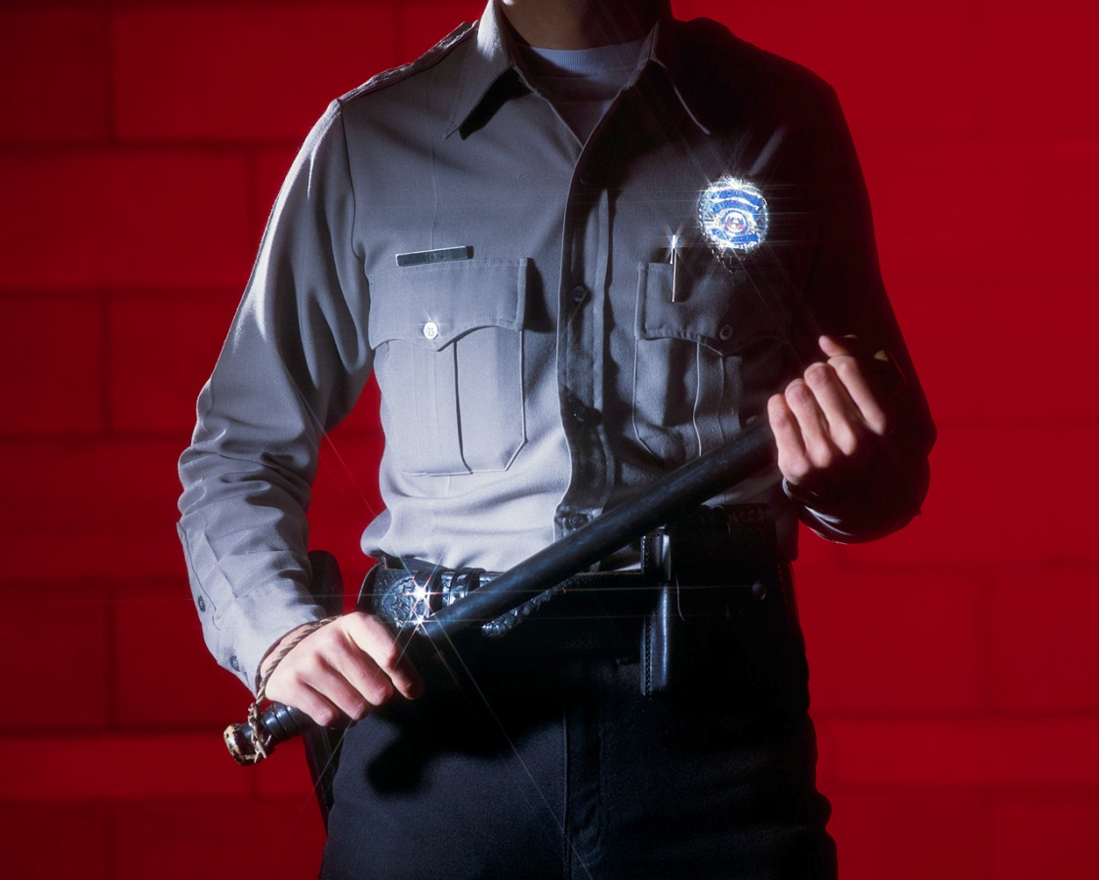
"Brooklyn Cop"
Norman MacCaig

Slide 5
Background
The poem, written in 1968, is based on an experience that MacCaig had in America.
Brooklyn was a rough district in New York.
Hieroglyphs are sacred symbols used in Egyptian picture writing, but these are now sometimes referred to as things which are difficult to read.
Nightstick is an American policeman’s truncheon.

Slide 6
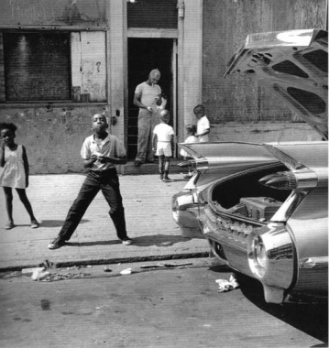
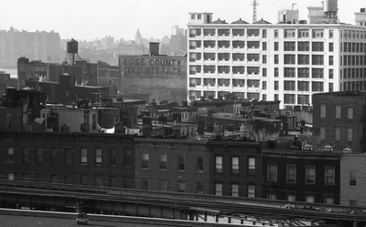
Brooklyn 1968

Slide 7
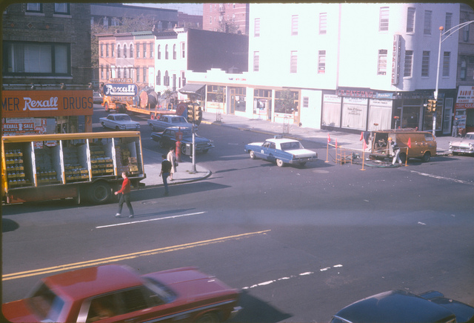
Brooklyn 1968

Slide 8
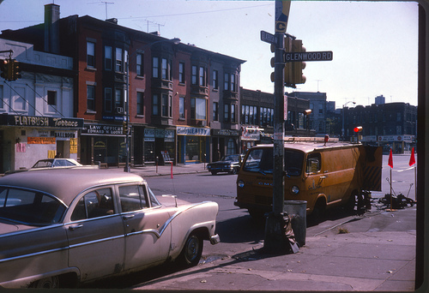
Brooklyn 1968

Slide 9
Norman MacCaig Introduces and Reads...
http://www.bbc.co.uk/programmes/p00c4kkr

Slide 10
Brooklyn Cop
Built like a gorilla but less timid,
thick‑fleshed, steak‑coloured, with two
hieroglyphs in his face that mean
trouble, he walks the sidewalk and the
thin tissue over violence. This morning,
when he said, "See you, babe" to his wife,
he hoped it, he truly hoped it.
He is a gorilla
to whom "Hiya, honey" is no cliché.
Should the tissue tear, should he plunge through
into violence, what clubbings, what
gunshots between Phoebe's Whamburger
and Louie's Place.
Who would be him, gorilla with a nightstick,
whose home is a place
he might, this time, never get back to?
And who would be who have to be
his victims?

Slide 11
Built like a gorilla but less timid,
thick‑fleshed, steak‑coloured, with two
hieroglyphs in his face that mean
trouble, he walks the sidewalk and the
thin tissue over violence. This morning,
when he said, "See you, babe" to his wife,
he hoped it, he truly hoped it.
He is a gorilla
to whom "Hiya, honey" is no cliché.

Slide 12
Should the tissue tear, should he plunge through
into violence, what clubbings, what
gunshots between Phoebe's Whamburger
and Louie's Place.
Who would be him, gorilla with a nightstick,
whose home is a place
he might, this time, never get back to?

Slide 13
And who would be who have to be
his victims?

Slide 14
The poem …
MacCaig describes
the physical appearance of a character from an urban environment.
The character’s psychological profile.
The character’s urban environment.
He writes about the character’s dangerous existence and the violent situations he finds himself embroiled in.
He also suggests that the character is just as dangerous as the criminal?

Slide 15
...is about.
Norman MacCaig depicts the character of a corrupt, thuggish American cop. A policeman is meant to inspire trust and is employed to 'serve and protect'. Instead the, "Gorilla with a nightstick", is insensitive, violent and appears to enjoy the murderous nature of his occupation.
However, despite his brutal nature and tough exterior, there is a gentler side to the cop, who loves his wife and fears for his life. The poem asks us to consider the violence that takes place within a city like New York, and whether the cop is partly responsible.

Slide 16
Emotions in the poem…
Policeman’s emotions created by the danger and tension of his job.
He is a frightening character, but he has to be to survive the terrors of city life.
Is sympathy felt for both the policeman and his victims?
How does MacCaig feel about the use of violence to prevent violence and uphold the law? Irony?

Slide 17
"Brooklyn Cop"
Norman MacCaig

Slide 18
Stanza 1
What does the opening line tell you about the cop?
What do the phrases ‘thick-fleshed’ and ‘steak coloured’ suggest?
What could the hieroglyphs refer to?
What connotations are suggested by ‘thin tissue over violence’?
What aspects of the first stanza contrast with each other?

Slide 19
Stanza 1 Summary
Describes physical appearance of the cop
Brutish, powerful, aggressive
Suggests a psychological description by reference to home-life and concerns.
Heavy contrast between tough public exterior and domestic, private side of the cop.

Slide 20
Stanza 2 Summary
Extends the tissue metaphor and explores the results of tearing the tissue – exploration of the urban environment
‘Plunge’ – key word, suggests impulsive and reckless aspects of the cop- instigator?
Names of establishments sound sleazy- suggests lack of dignity.

Slide 21
Stanza 3 Summary
Tone changes and moves from descriptive commentary to reflective.
Again gorilla metaphor is extended.
“Home” literal and metaphorical meaning. He might not get home or he might lose his humanity through his constant involvement with violence.

Slide 22
Stanza 4 Summary
Reflective tone continues
Suspects/criminals referred to as victims – key to the meaning of the whole poem.
Irony of use of violence in preventing violence.
Pessimistic tone?

Slide 23
"Brooklyn Cop"
Norman MacCaig

Slide 24
Imagery
“built like a gorilla” - tells us he is big and strong and is a stereotypical image of a New York cop.
“..but less timid”- suggests he is brave, but brutal
“he walks the sidewalk and the thin tissue over violence” - the divide between civilisation and violence is only ever paper-thin.
“two hieroglyphs in his face that mean trouble” - he is seeking out violence MacCaig uses the simile at the start of the poem, "built like a Gorilla", but towards the end of stanza one he changes the comparison to a metaphor, "he is a gorilla".
This strengthens the image and emphasises the savage, bestial and primitive nature of the cop.

Slide 25
Word Choice
“Phoebe’s Whamburger” and “Louie’s Place” – sound like they might be mafia diners or places where gangsters might hang out.
"nightstick"- It is significant that MacCaig has chosen a nightstick, because stereotypical police would have a gun. The Brooklyn Cop has a nightstick, perhaps because he enjoys being able to use it to violently beat up criminals.
Plunge” - suggests falling quickly. It has connotations of falling, uncontrollably, perhaps from a great height into something terrible, like the “thin tissue” into violence
“honey” - has tender associations, and his fear that his “home is a place he might, this time, never get back to” tells us that he is vulnerable.

Slide 26
Setting
‘Brooklyn’ tells us that the poem is set in a poorer part of New York, and it is generally known that crime is more common in poorer parts of the city.
The setting emphasises the violence and corruption in the poem.

Slide 27
A Complex Character
The poem explores the relevant and important issue of police brutality. Should we feel sympathy for a family man who has been hardened by everyday violence, or instead be disgusted by his brutal policing, which seems to have little effect?
Perhaps you found the poem effective because it describes a realistic character who is both vulnerable, and violent.

Slide 28
"Brooklyn Cop"
Norman MacCaig

Slide 29
Textual Analysis

Slide 30
Stanza One
Look at lines 1 – 4. Do you think that this is a stereotypical image of a policeman? Choose two quotes, and explain why they make you feel this way. (3)
Quote the line that shows that the divide between civilization and violence is only ever paper-thin. (1)
What technique is this? (1)
Consider what you learn about the cop at home. Quote a line that shows the difference between his personality at work, and that at home. Explain your answer fully, including how you feel about the character. (3)
The poet changes from saying the cop is “like a gorilla” to being “a gorilla”. Explain fully how the techniques have changed, and why you think the poet does this. (2)

Slide 31
Stanza One
Stereotypical – “built like a gorilla” = he is big and strong / “..but less timid” = brave
Non-stereotypical – “two hieroglyphs in his face that mean trouble” = he is looking for trouble (1 mark for each quote and linked opinion)
“he walks the sidewalk and the thin tissue over violence” (1 mark)
Metaphor (1 mark)
Whilst at work, he is fearless and savage. But he loves his wife and is afraid that he might be killed in the line of duty (1 mark) - “.. when he said ‘see you babe’ to his wife, he hoped it, he truly hoped it” (1 mark). This makes us feel sorry for him because his love for his wife means he is vulnerable. (1 mark)
The poet uses a simile at the start of the poem, but towards the end of stanza one he changes the comparison to being a metaphor (1 mark). This strengthens the image and emphasises the savage, bestial and primitive nature of the cop. (1 mark)

Slide 32
Stanza Two
Think about the place names in the poem – what kind of area is he policing? (2)
Explain how the word “plunge” is effective. Include comment on connotation and denotation of the word as well as the structure. (3)
How does stanza two remind us of the themes of the poem? (1)

Slide 33
Stanza Two
The poet mentions “Phoebe’s Whamburger” and “Louie’s Place” – these sound like they might be mafia diners or places where gangsters might hang out. (2 marks for any suitable ideas with evidence)
“Plunge” means to fall quickly (1 mark). It has connotations of falling, uncontrollably, perhaps from a great height into something terrible (1 mark). . The poem highlights the word so that the physical structure of the poem almost mirrors the idea of falling through the “thin tissue” into violence. (1 mark).
Stanza two reiterates the theme of violence, and shows how quickly the cop could be thrust from safety into chaos. (1 mark for anything describing how violence is always present in the cop’s world)

Slide 34
Stanza Three
What do you notice about the structure of this stanza? (1)
Explain the significance of “gorilla with a nightstick” (2)
Show how the poet tries to get us to sympathise with the cop (4)

Slide 35
Stanza Three
The whole stanza is written as a rhetorical question. (1 mark)
The cop is described as a gorilla, which has connotations of being primitive and savage. It is significant that he has chosen a nightstick, because stereotypical police would have a gun. The Brooklyn Cop has a nightstick, perhaps because he enjoys being able to use it to violently beat up criminals. (1 mark) The poet may also intend it to be a phallic symbol, to emphasise the masculinity of the cop. (1 mark)
MacCaig tries to get us to feel sorry for the cop by reminding us that his “home is a place he might, this time, never get back to.” This is perhaps the only place he is happy and safe and so we sympathise with his dangerous life. (2 marks) The poet also asks “who would be him”, which makes the reader consider how hard it would be to live the life the cop does. (2 marks) (1 mark for each quote,1 mark for each reasonable explanation)

Slide 36
Stanza Four
Who is the poet referring to as “victims”, and why do you think they are referred to as such? (2)

Slide 37
Stanza Four
The poet refers to criminals who are caught by the cop as “victims” (1 mark), perhaps because the cop serves his own kind of violent justice. (1 mark)

Slide 38
Overall
Why do you think the Brooklyn Cop remains anonymous? (1)
How successful do you think this poem is in conveying a complex picture of the cop? (4)

Slide 39
Overall
I think that not knowing his name emphasises how isolated he is from society, and makes the readers sympathise more with him (1 mark)
MacCaig is successful because he presents us with a realistic character. On one hand, he is almost a comic book superhero: he is “built like a gorilla” – huge and strong, as he bravely “walks the sidewalks and the thin tissue over violence” to keep us safe.
On the other hand, he has a vicious, violent streak. He likes brutalising people, and the line “two hieroglyphs in his face that mean trouble” suggests he seeks out fights.
Yet at the same time, he is tender with his wife, calling her “honey” and his fear that his “home is a place he might, this time, never get back to” tells us that he is vulnerable.
(two marks each for suitable quote plus explanation)

Slide 40
Brooklyn Cop: Notes

Slide 42
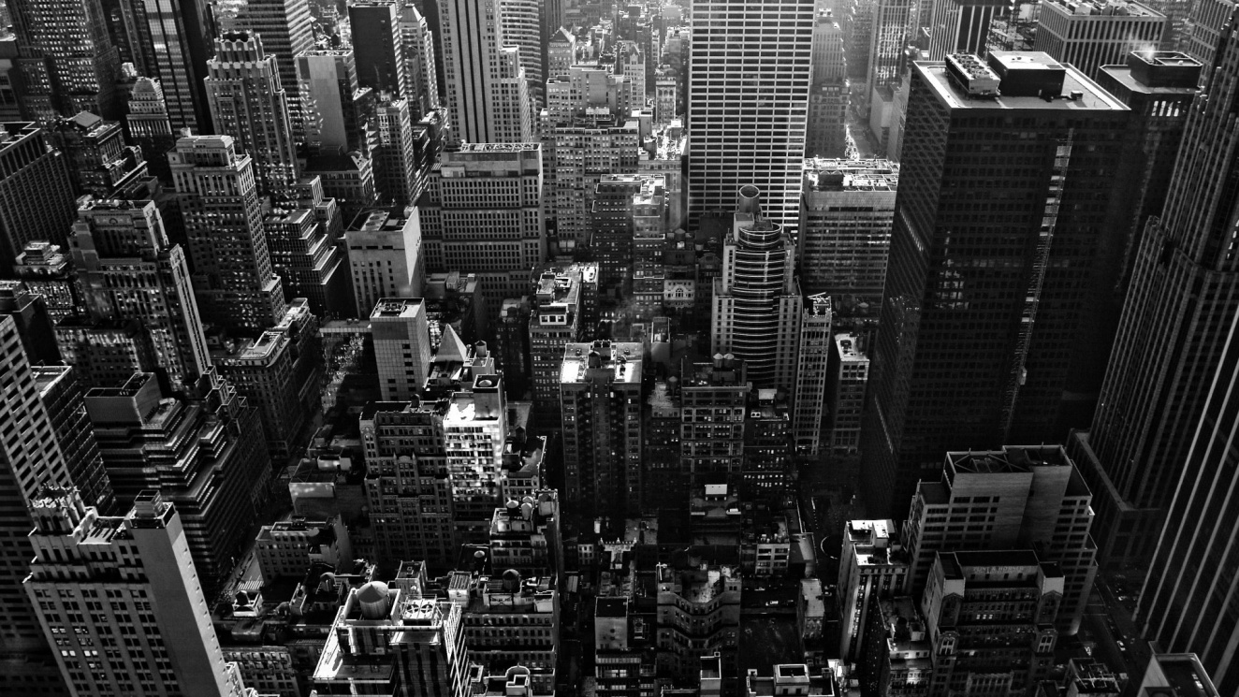
Hotel Room, 12th Floor
Norman MacCaig

Slide 43
This morning I watched from here
a helicopter skirting like a damaged insect
the Empire State building, that
jumbo size dentist’s drill, and landing
on the roof of the PanAm skyscraper.
But now Midnight has come in
from foreign places. Its uncivilised darkness
is shot at by a million lit windows, all
ups and acrosses.

Slide 44
But midnight is not
so easily defeated. I lie in bed, between
a radio and a television set, and hear
the wildest of warwhoops continually ululating through
the glittering canyons and gulches –
police cars and ambulances racing
to broken bones, the harsh screaming
from coldwater flats, the blood
glazed on the sidewalks.

Slide 45
The frontier is never
somewhere else. And no stockades
can keep the midnight out.

Slide 46
Hotel Room, 12th Floor
Norman MacCaig

